Slide 1
Employee Access True Time & Time Off Refresher
Fall 2012

Slide 2
Link to Employee Access can be found out website: http://www.hasd.org/businessservices/employeeaccess.cfm
If you forgot Login ID &/or Password. Click Forgot your Login/Password? Or e-mail Wendy or Tera

Slide 3
What’s the difference between True Time & Time Off?
True Time
is only for time worked.
If you are not here for any reason, do nothing in True Time. Do NOT manually enter paid time off in True Time.
Time Off
is only for paid time away from work, i.e., Sick, Personal, Vacation, Jury Duty, Funeral.
If you are absent & it is unpaid Time Off, do nothing in Employee Access!

Slide 4
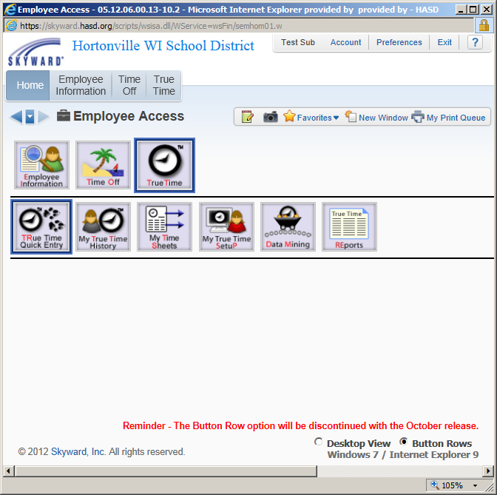
Changes to Employee Access
Changes affect both True Time & Time Off Screens & access. The next two screens are focused on True Time but can be applied to Time Off as well.
October 2012….the front page of Employee Access will be changing, from this view to….

Slide 5
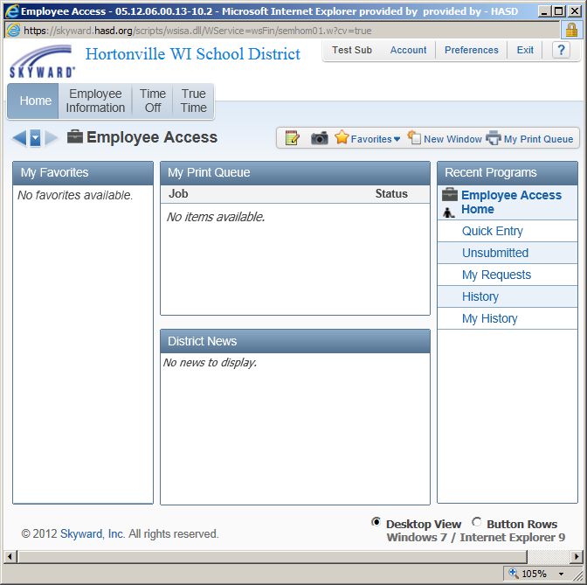
The Button Rows, will be going away. They will be replaced with a Desktop View.

Slide 6
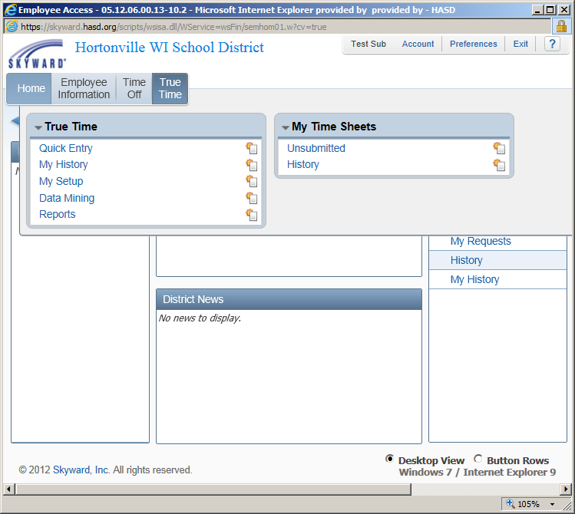
Access to Quick Entry Screen is True Time > Quick Entry.

Slide 7
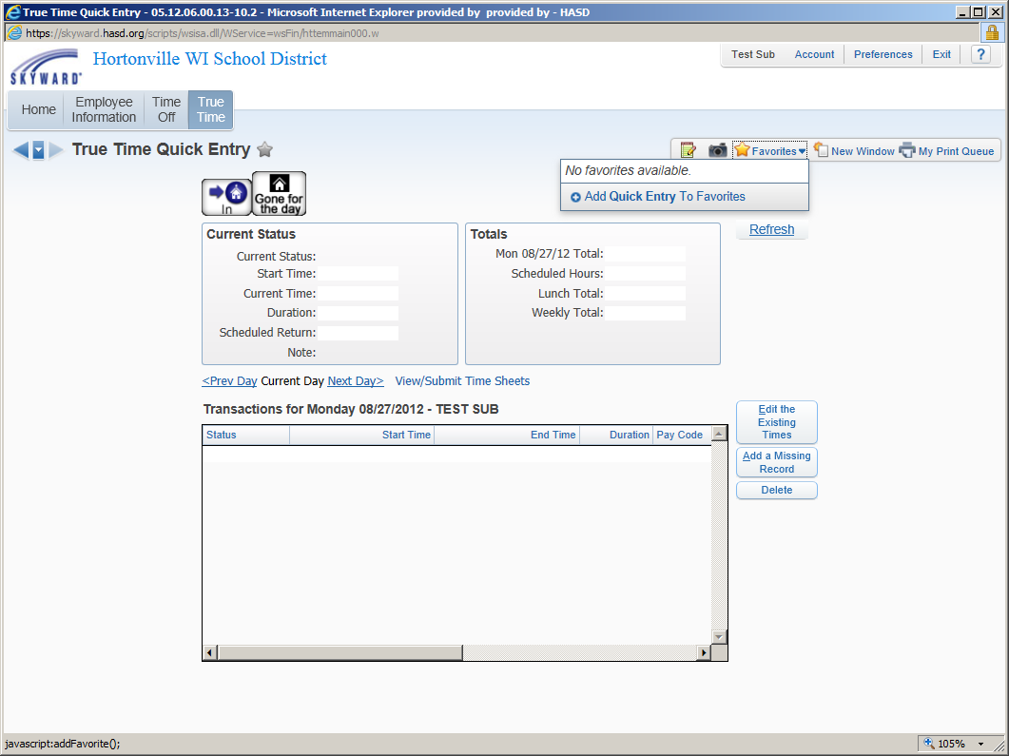
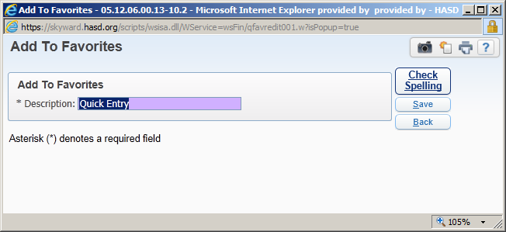
Hints:
Adding Quick Entry to your Favorites will allow one click access to Quick Entry Screen.
This is true for all screens you frequently use.

Slide 8
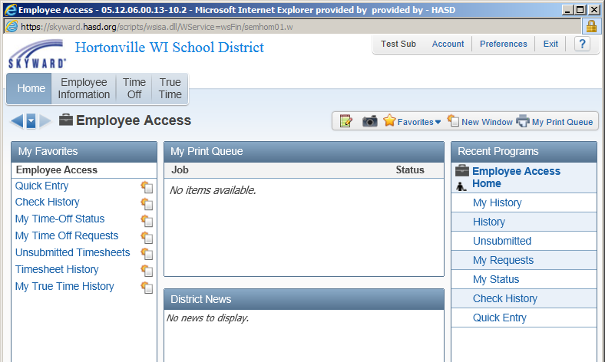
After adding Quick Entry to Favorites, it’s one click to the screen:

Slide 9
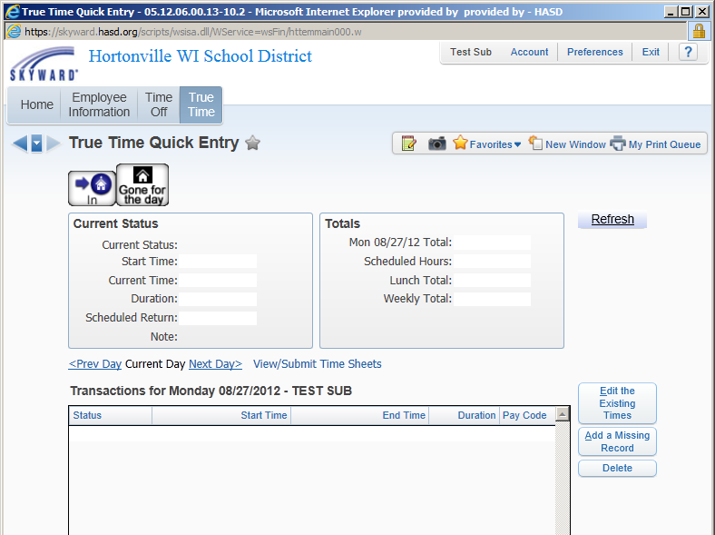
Punching In
To begin your record for the CURRENT day. Click IN.
If you are punching in late because you were interrupted, or otherwise detained, still click IN button, then edit start time.

Slide 10
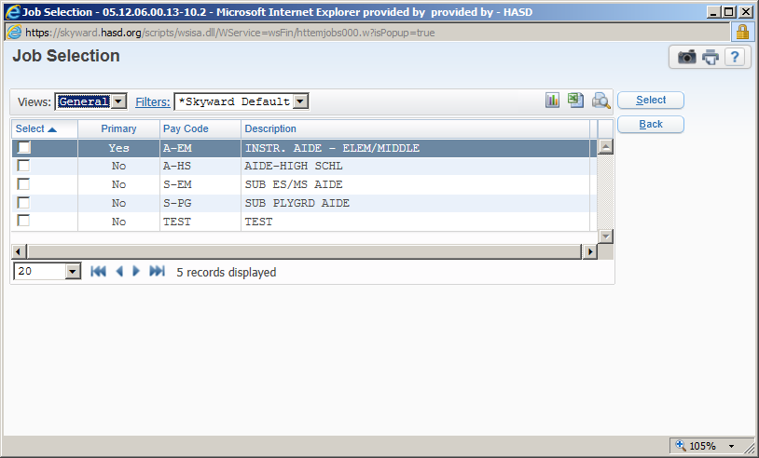
Job Selection
When/If necessary, choose a Job in the Job Selection Screen, then Save.

Slide 11
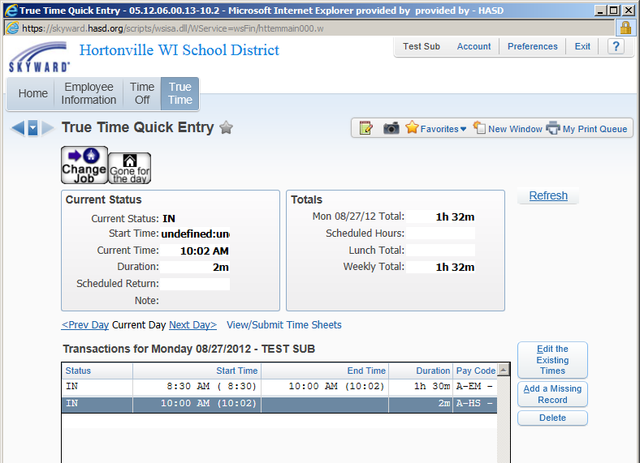
Edit Times
To edit start time, Click Edit the Existing Times.

Slide 12
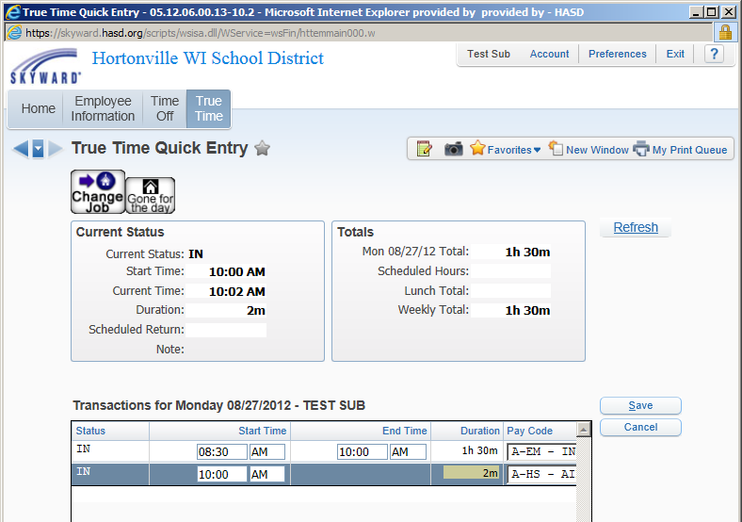
Editing Times
Highlight the hour(s) to change. Make your correction, then click SAVE to save the entry.

Slide 13
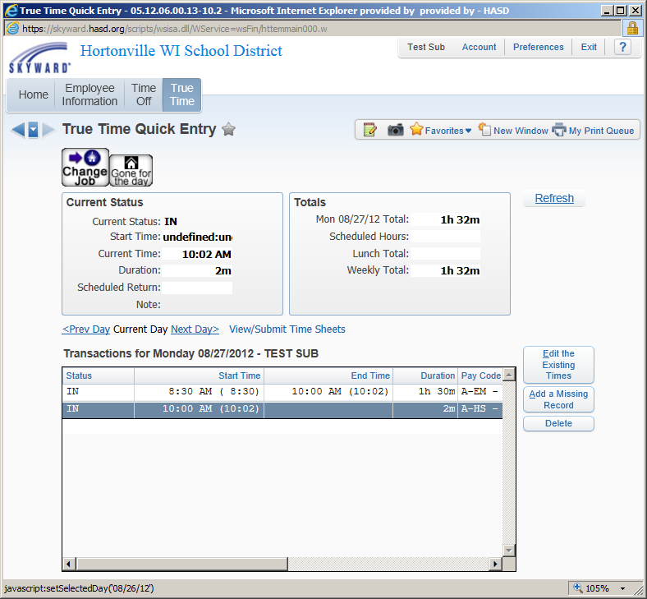
Job Change
To change jobs, click CHANGE JOBS, then choose which job to do. A new screen will appear, select the box of the job, then click SELECT.

Slide 14
For those without the Auto-Generated Lunches:
If you are going on a break or lunch for more than 30 minutes, you can choose GONE for the DAY or LUNCH, if you have the option. Remember to login again upon returning.
For Everyone: If your lunch is less than 30 minutes, please e-mail Business Office that day.

Slide 15
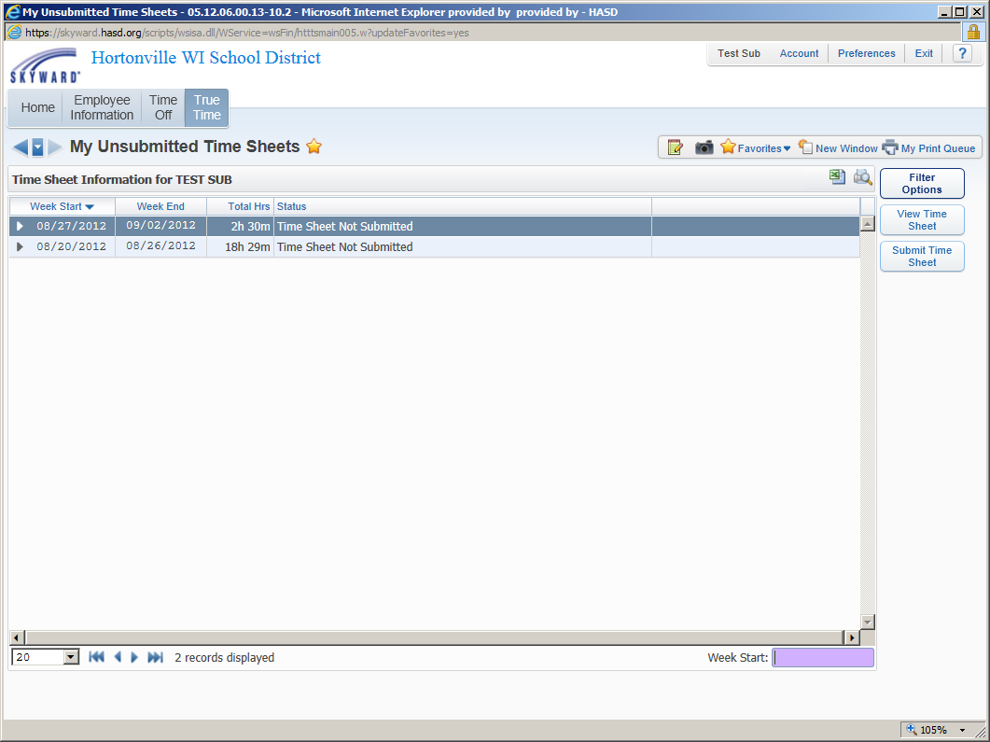
Submitting Timesheets
There are two ways to access Un-submitted Timesheets:
True Time Button >My Timesheets > Un-submitted
or if you’ve created a Favorite link, it will be listed there.
Submit Timesheet

Slide 16
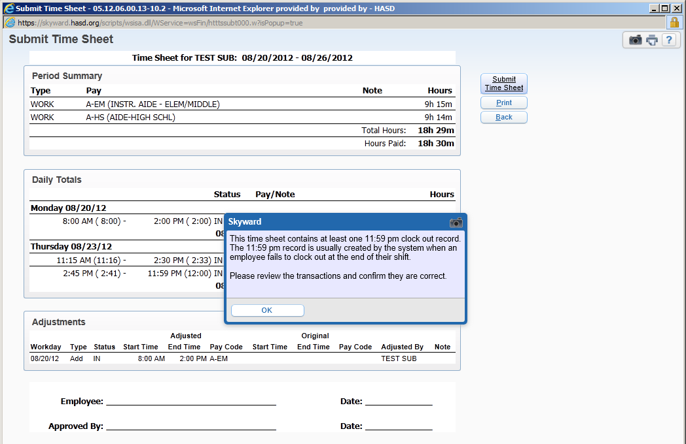
Submitting Timesheets - ERRORS
If you receive an error message like this, you need to Edit the Day In Question. This is an error that occurs if you forgot to punch out upon leaving for the day.
To Correct, click Back Button.

Slide 17
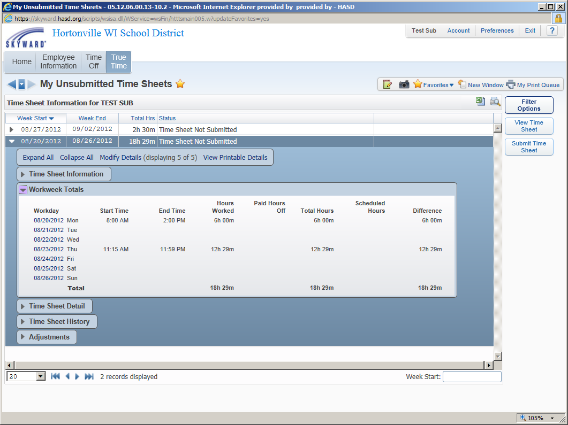
Submitting Timesheets – Correct Error
Expand Timesheet in question. Expand Workweek Totals. Select Day in question, Quick Entry Screen will pop-up. Edit Existing times as indicated on previous slide.

Slide 18
Submitting Timesheets
If no Errors, or have corrected existing errors, Submit, preview screen will pop-up, Submit, then Save.

Slide 19
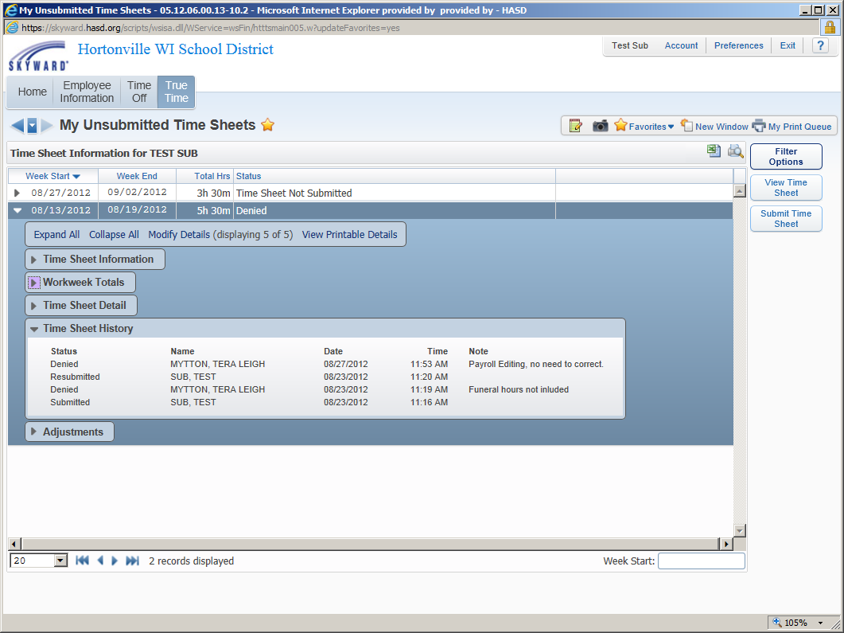
Often times it is necessary for us to edit timesheets that have been submitted or approved by your supervisor. To do this we may have to deny a timesheet. You will receive an email saying it was denied, you do not need to call, If you see on the screen to the right, My Un-submitted, under Timesheet History…the Notes often tell what happened.
Denied Timesheets
Deny Notes

Slide 20
Time Off Requests

Slide 21
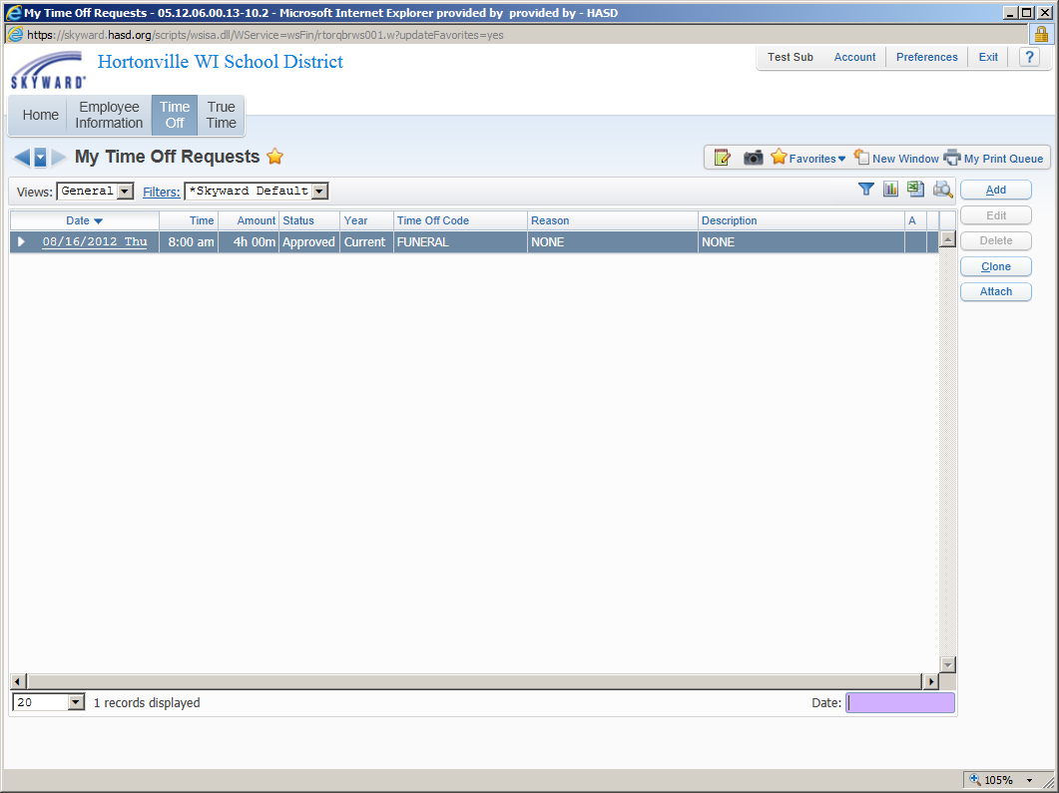
Time Off Request
Time Off >
My Requests >
Add

Slide 22
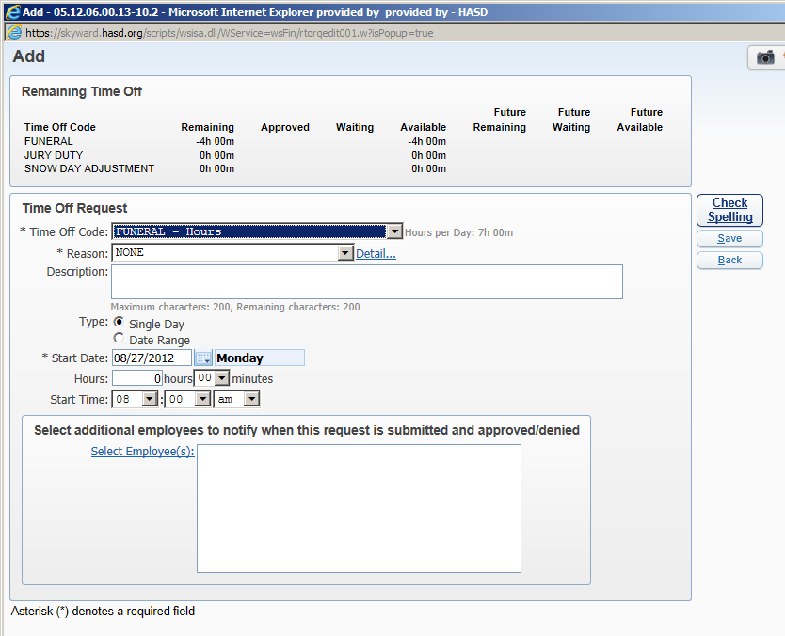
Time Off Request
Enter:
Time Off Code
Description
Choose Type: Single Day or Date Range
Enter Start Date & End Date if using Range
Enter Hrs/Min if using Single Day
Start Time, optional
Select Employees: Only those other than Supervisor or Tera
SAVE

Slide 23
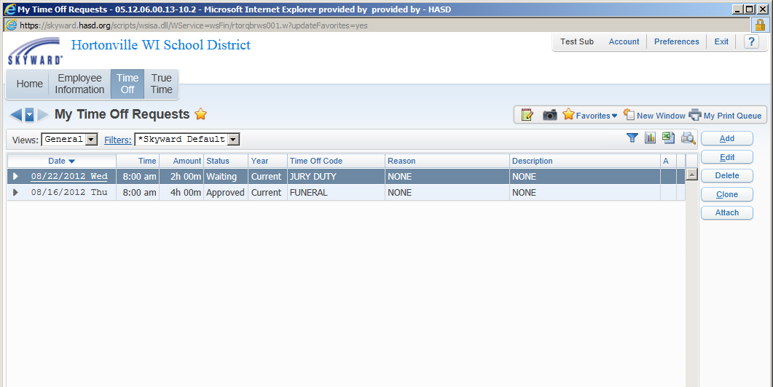
Time Off Request
Status will be Waiting, Approved, or Denied.
If Denied you should get an email on what needs to be corrected, if you don’t, then the Business Office is making the correction.
You can correct, by clicking Edit.

Slide 24
Time Off Status
By hovering over the Column Headings, you will see a brief description of their meanings.
FYI: Funeral, Jury Duty & Snow Days will be a negative number if any are used current year. We do not allocate those types of time off.

Slide 25
Time Off ‘FYI’
It is highly suggested that unless you know the exact times you will be off of work, you wait until the day/time you return from time off before submitting.
For example, you may plan for a doctor’s appointment to be 3 hrs. & you return in only 2 hrs. It’s easier to add the Time-Off Request after the fact, then to try and correct later.
For those using True Time, having an appointment mid-day, you should punch out as “Gone” & upon your return punch “IN” then add the missing time to Time-Off.

Slide 26
Business Office Web Resources
Fall 2012

Slide 27
Link to Employee Access can be found out website: http://www.hasd.org/businessservices/index.cfm

Slide 28
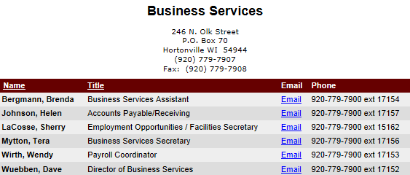
Business Services Page
Contact Info

Slide 29
Business Services Page
Department Responsibilities
Dave Wuebben – School District Business, Budget, HR
Brenda Bergmann – Benefits/HR/Handbooks/Contracts
Wendy Wirth – Payroll/Sick-Personal – Teachers/Skyward EA
Helen Johnson – AP/Receivable/PO/Employee Reimbursements
Sherry LaCosse– HR/Employment Opportunities/Facilities
Tera Mytton – Employee Accidents/Flex Spend/Time-off-NON Teaching Staff/Expense Reports /Skyward Financial & EA/OE/3rd Friday

Slide 30
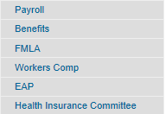
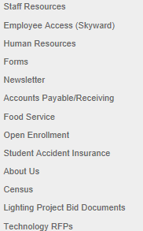
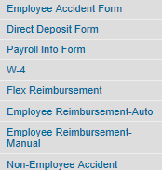
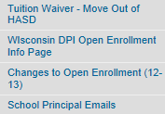
Key Menu Items

Slide 31
Staff Resources
Payroll
Benefits
Workers Comp (Employee Accidents)
FMLA
EAP - Employee Assistance Program
Health Insurance Committee

Slide 32
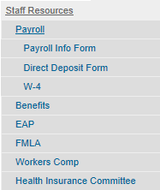
Payroll
Business Services Contact: Wendy Wirth Ext. 17153
wendywirth@hasd.org
Frequently Requested Forms:
Payroll Info Form
Direct Deposit Form
W-4

Slide 33
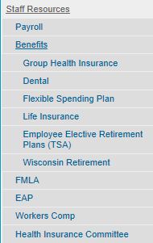
Benefits
Business Services Contact: Brenda Bergmann Ext. 17154
brendabergmann@hasd.org
Health Insurance
Dental
Flex Spending
Life Insurance
TSA
WRS
FMLA
EAP

Slide 34
Flex Spending
Business Services Contact: Tera Mytton Ext. 17156
teramytton@hasd.org
The Flexible Benefit Plan allows you to pay for certain Health Related expenses using Pre-Tax Money.
Prescription Drugs
Glass/Contacts
Dental/Orthodontic
Chiropractic
Certain Daycare Fees
Visit our Website for Enrollment Materials for the
2012-13 Plan year

Slide 35
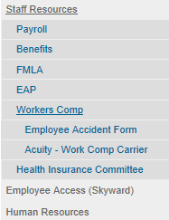
Work Comp
Business Services Contact: Tera Mytton Ext. 17156
teramytton@hasd.org
During the upcoming year (12-13) our reporting method will be changing. Coming soon, Medcor will take over our reporting of work place accidents. Until that is in place, continue to complete the Employee Accident Form & return to Tera as soon as possible.

Slide 36
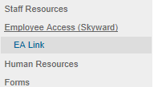
Employee Access
Business Services Contact: Tera Mytton Ext. 17156 or Wendy Wirth Ext. 17153
teramytton@hasd.org; wendywirth@hasd.org
Link to Employee Access & Skyward Financial Website
Tutorials

Slide 37
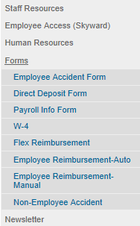
Forms/Newsletter
Short cut to frequently requested forms:
Employee/Non-Employee Accident
Direct Deposit & Payroll Info Form
W-4
DBS Flex Reimbursement
Employee Expense/Mileage Reimbursement
Business Office Newsletter

Slide 38
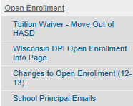
Open Enrollment/Student Accident Insurance
Open Enrollment:
Helpful information, dates & links for Parents or Staff with questions. Please direct Parents to this informative page.
Student Accident Insurance:
Claim Form, to be filled out by School personnel – secretary, health aide or nurse. Parents are responsible for submitting claims.
Questions regarding submitting or following up on a claim should contact our Student Accident Carrier – Student Assurance Services.

Slide 39
The preceding slides will be available on the Business Office Webpage for future reference or clarification.
http://www.hasd.org/businessservices/staffresources.cfm

